Slide 1
Housing Rights Workshop
Burbank, CA
Henry Mantel
Pro Bono Coordinator
Notes:
Michael

Slide 2
Overview of Workshop
Stay Housed LA
Evictions and Tenant Protections
AB 1482: The Tenant Protection Act of 2019
Implied Warranty of Habitability
Fair Housing
Questions

Slide 3


Legal Service Providers:
  Asian Americans Advancing Justice, BASTA, Bet Tzedek, CLA SoCal, EDN, HRC, ICLC, LAFLA, Mental Health Advocacy Services, NLSLA, Public Counsel
Website: https://www.stayhousedla.org/
Stay Housed LA is a county-wide program to educate tenants on their rights and provide legal assistance to those facing eviction
The goal of Stay Housed LA is to keep people in their homes
2
Notes:
Michael

Slide 4

Stay Housed LA Resources
Workshops
  https://www.stayhousedla.org/workshops
Legal Aid Referral
  https://www.stayhousedla.org/get-legal-help
Self-Help
  https://www.stayhousedla.org/self-help-eviction-defense

Slide 5
Evictions and
Tenant Protections

Slide 6
The Eviction Process
An unlawful detainer, or an eviction, is a process by which the landlord attempts to regain possession of the property from a tenant.
Summary proceeding because what is primarily at issue is the POSSESSION of the property.
Because it’s a “summary proceeding,” it has its own special section in the Code of Civil Procedure: Secs. 1161 – 1179
UD vs. Forcible Detainer
Self-Help by landlords is illegal

Slide 8
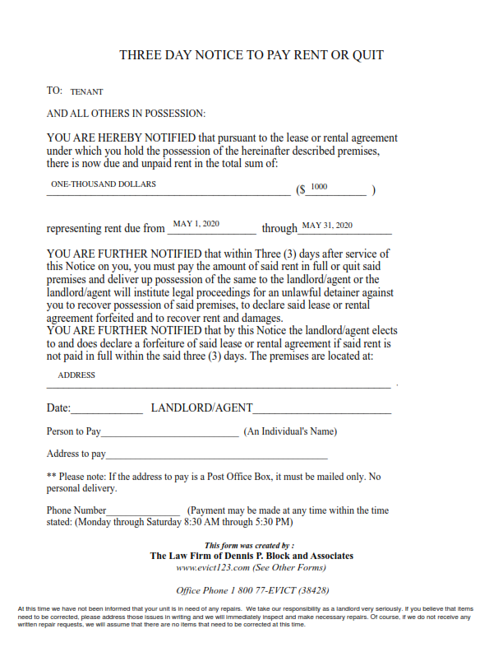
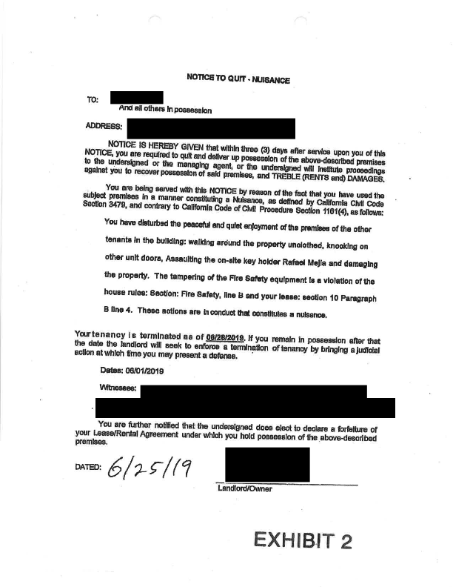

Slide 9
Basics: Terminating the Tenancy:
California Code of Civil Procedure §1161
7 Reasons to Terminate:
  1161(1) – Expiration of the lease
    30 Day Notice, or 60 Days if tenant has lived there more than a year. (Civ. Code 1946.1)
  1161(2) – Nonpayment of rent
    3 Day Notice to Pay or Quit
  1161(3) – Breach of the terms of the lease
    3 Day Notice to Cure/Perform
  1161(4) – Nuisance/Unlawful Use of the Premises
    3 Day Notice to Quit
  1161(5) – Tenant surrenders the lease
  1161a – After sale of a mobile home
    If you are a renter, up to 30 days notice
  1161b – After a foreclosure
    If you are a renter, 90 Days Notice
3
Notes:
Michael
Q: How to determine which protections apply?

Slide 10
Affirmative Defenses
An affirmative defense is a defense against eviction that a tenant can apply in an unlawful detainer action, either at trial or in a pre-judgment motion
Common affirmative defenses:
  Waiver
  Estoppel
  Defective notice
  Breach of Warranty of Habitability
  Retaliation
  Discrimination
Affirmative defenses must be listed in the Answer to be applied at trial
Notes:
Tina
Questions

Slide 11
Right of Entry and Voidable Lease Terms
Landlord’s right of entry (Civil Code 1954)
  LL may enter:
    In an emergency (Notice NOT required)
    To make necessary/agreed upon repairs, or to show the apartment (Notice required)
  Must provide reasonable written notice of intent to enter (24 hours presumed reasonable)
    Must describe the reason for entry
    Must be mailed or delivered to tenant. (6 days notice, if mailed)
  Entry must be during normal business hours
Lease terms that are void as against public policy (Civil Code 1953):
  Waiver of tenant’s rights regarding security deposits or landlord entry.
  Waiver of tenant’s right to sue the landlord for future claims.
  Waiver of tenant’s right to a notice or hearing required by law.
  Waiver of procedural rights in any action involving tenant’s rights or obligations.
  Waiver of landlord’s duty of care to prevent personal injury or property damage.
Notes:
Michael

Slide 12
Laws Based on Housing Receiving Government Funding
Public Housing (Government owns the building) – Look to the rules/administrative plan of the agency that owns the building.
Section 8 Projects (The “Unit” is affordable) 24 CFR Part 983
Section 8 Vouchers (The “Person” carries affordability with them) - 24 CFR Part 982
Low Income Housing Tax Credit (IRS/CTCAC)
  Rent amount tied to income brackets.
  Requirement for good cause for evictions. (IRS Rev. Ruling)

Slide 13
AB 1482: The Tenant Protection Act of 2019

Slide 14
What is the TPA?
State-wide just-cause protections and rent control
  Landlords must show “just cause” to terminate the tenancy. (Civil Code 1946.2)
  Landlords are limited in how much they can raise rent annually (5% + % change in CPI OR 10%, whichever is lower). Civil Code 1947.12.
    Adding on extra fees and costs would be considered a rent increase
      Charging tenants for common area utilities probably counts
  Applies (basically) to any property with 2 or more rental units (not including owner’s unit), built within last 15 years.
    Exceptions (Civil Code §1946.2(e))
      Single-family homes owned by an individual OR owner-occupied
      Dormitories
      Certain affordable housing
Notes:
Tina

Slide 15
Just-Cause Protections
At-Fault Just Causes
  Non-payment of rent
  Breach of lease
  Nuisance
  Committing waste
  Refusal to execute an extension of an expired lease
  Criminal activity
  Improper subletting
  Refusal to allow proper entry
No-Fault Just Causes
  Intent to occupy by owner or owner’s direct family
  Withdrawing property from rental market
  Government order
  Demolish or substantial remodel
No-fault requires relocation assistance equal to one month’s rent

Slide 16
Burbank Urgency Tenant Protection Ordinance
Passed 9/12/23, Effective Immediately
Heightened Just-Cause Protection
Heightened Relocation Assistance
Extra requirements for evictions based on intent to demolish or substantially remodel property
  Permits must be secured
  Tenant has been provided with the permits
  Tenant provided with account of scope of work, why they need to move, and why it will take more than 30 days
Landlords are now required to provide relocation assistance equal to at least three (3) months of rent in No-Fault evictions when the just cause is to demolish or substantially remodel the property

Slide 17
Implied Warranty of Habitability

Slide 18
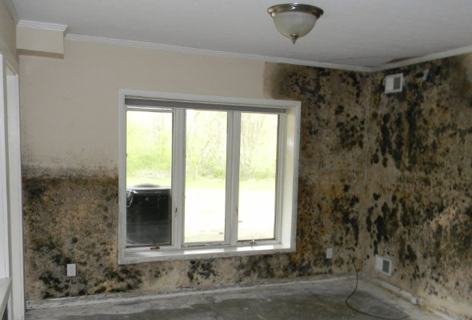
What is the Warranty of Habitability?
A landlord has a duty to maintain the leased premises so that they are fit for human habitation
The warranty is implied, regardless of what the lease or rental agreement says
The warranty cannot be waived, explicitly or implicitly
Breach of the Warranty may be a defense to eviction

Slide 19
Habitability Standards
Webster’s Dictionary: “capable of being lived in, suitable for habitation”
Untenantable dwellings “substantially lacks any of the following affirmative standard characteristics or is a residential unit described in Section 17920.3 or 17920.10 of the Health and Safety Code:
Civil Code Sec. 1941.1

Slide 20
Tenant options
Inform the Landlord
Repair and Deduct
Withhold rent
Report to a government agency
Move out / Constructive Eviction
File suit against Landlord
Retaliatory Evictions
  Landlords cannot retaliate against tenants who report unsafe or illegal conditions
  Attempts to evict within 180 days of tenant reporting conditions to landlord or government presumed retaliatory

Slide 21
Fair Housing

Slide 22
Protections Against Discrimination
Against Private Parties:
  Unruh Civil Rights Act (Civil Code Sec. 51)
  FEHA (Fair Employment and Housing Act (Gov. Code Sec. 12955)
  Fair Housing Act (42 U.S.C. Secs. 3601, 3604)
    Note: FEHA and FHA do not apply to certain homes occupied by owners with less than a certain number of units. Unruh applies to every landlord.
Prohibiting Discrimination in Government Funded Programs
  Government Code 11135 (California)
  Title VI of the Civil Rights Act of 1964 (Federal)
  Section 504 of the Rehabilitation Act of 1973 (Federal)
Americans with Disabilities Act (Federal)
Notes:
Michael
Questions:

Slide 23
Unruh Civil Rights Act
“All persons within the jurisdiction of this state are free and equal, and no matter what their sex, race, color, religion, ancestry, national origin, disability, medical condition, genetic information, marital status, sexual orientation, citizenship, primary language, or immigration status are entitled to the full and equal accommodations, advantages, facilities, privileges, or services in all business establishments of every kind whatsoever.”
Basic civil rights law of the state.

Slide 24
FEHA (Gov. Code Secs. 12927, 12955)
Unlawful for the owner of any housing accommodation to discriminate against or harass any person because of the race, color, religion, sex, gender, gender identity, gender expression, sexual orientation, marital status, national origin, ancestry, familial status, source of income, disability, veteran or military status, or genetic information of that person
Source of Income discrimination
  A landlord cannot refuse to accept a tenant based on source of income, such as Section 8
  HOWEVER, a landlord can inquire as to a tenant’s source of income
Discrimination includes:
  refusal to sell, rent, or lease housing accommodations;
  refusal to negotiate for the sale, rental, or lease of housing accommodations
  representation that a housing accommodation is not available for inspection, sale, or rental when that housing accommodation is in fact so available;
  provision of inferior terms, conditions, privileges, facilities, or services;
  Harassment;
  Cancellation or termination of a sale or rental agreement;
  Segregated or separated housing accommodations;
  Refusal to permit reasonable modifications of the premises if the modifications are necessary to afford a disabled tenant full enjoyment of the premises,
  Refusal to make reasonable accommodations in rules, policies, practices, or services when necessary to afford a disabled person equal opportunity to use and enjoy a dwelling.

Slide 25

Disability Discrimination
Landlords are required to make “reasonable accommodations” to tenants with disabilities
  So long as they do not create an undue burden on the landlord
A disability can be anything that substantially limits a person’s major life activities
Discrimination can be a defense against eviction

Slide 26
Government Agency Enforcement
Agency | Number of Units | Location | Substance
County of L.A. Department of Public Health | Any | County | Health: rodents, mold, lead, CO2, etc.
California Civil Rights Department | Any | State of California | Discrimination
Burbank Housing Authority / HUD | Any | City / Federal | Section 8, public housing
Environmental Protection Agency | Any | Federal | Lead safe repairs

Slide 27
Questions?
4
Notes:
Tina

Slide 28
NLSLA Hotline
(800) 433-6251
StayHoused LA Hotline:
1 (888) 694-0040

